Slide 2

A
Component A: Home
A
1
1
Component A.1 : Sections cards
Each card link the home to the Section page.
2
Component A.2 : News
This is a carousel with 3 random news of the last 3 days.
2
3
Component A.3 : Tournaments
This component contains 3 cards of two different models/components, filled with random tournaments:
1. Upcoming tournaments
2. Started and finished tournaments
3
4
Component A.4 : Gamers
This section contains 4 cards (same format) filled with different random profiles.
4
4
Component A.4 : Footer
This component is the same for all pages. Contains social media, legal and policy.
4

Slide 3
B
C
B
Component B: Teams page
1
Component B.1 : Teams cards
Contains the cards for each team and each card routes to the team page
1
1
B
Component C: Players page
1
Component C.1 : Players cards
Contains the cards for each gamer ranked from the #1 to the #50 ranked. Includes gamers of all teams.
2
Component B.2 and C.2 : Footer
This component is the same for all pages. Contains social media, legal and policy.
2
2

Slide 4
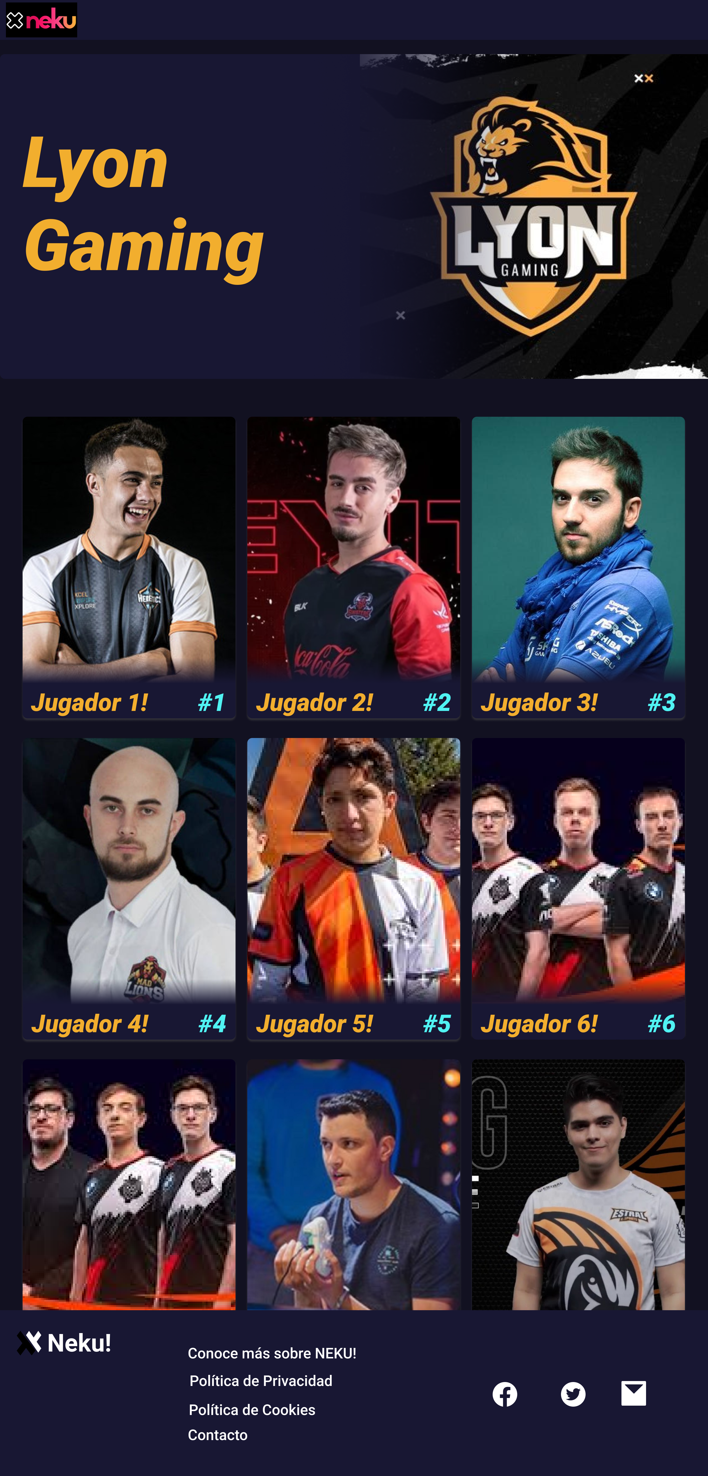
D
D
Component D: Single Team Page
1
Component D.1 : Players cards
Contains the cards for each gamer of the team, ranked form #1 to #n.
1
2
Component D.2: Footer
This component is the same for all pages. Contains social media, legal and policy.
2

Slide 5
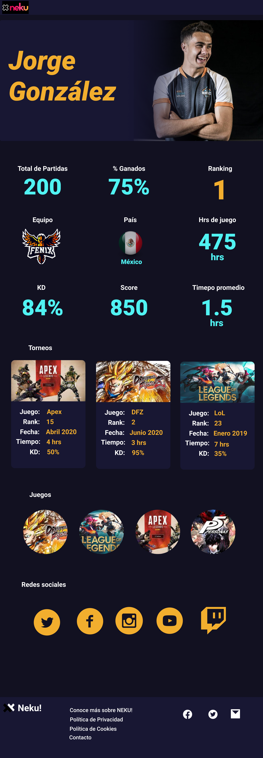
E
E
Component E: Player Profile Page
1
Component E.1 : Players statistics
Contains statistics and gamer profile information. These are avg of the different games in order to have a general profile.
1
2
Component E.2: Tournaments
Contains cards of all the tournaments played. Each row of cards contains 3 cards and if a a new card is added it will be placed below, in a new row. Each card contains information of the tournament
2
3
Component E.3: Games
Contains circles with the image of the game played by the gamer.
3
4
Component E.4: Social Media
Contains icons with all the social media of the gamer.
4
5
Component D.2: Footer
This component is the same for all pages. Contains social media, legal and policy.
5

